Slide 1
#AWS20100302001 AlphaFields 6x6x6 Transformation/Renewal Coordination Matrix
A Systematic Transformation & Renewal Coordination Approach
for Extended-Enterprise Transformation Acceleration

Slide 2
The Need for A Systematic Transformation & Renewal Coordination Approach for Extended-Enterprise Transformation Acceleration
Emerging new competition in
systemic innovations require
further transformation in…
Speed
Innovation
Service levels
Cost effectiveness
Business alignment
“Platforms”
In extended systems-enterprise renewal
& transformation, such acceleration
perspectives interpret into..
Extended Enterprise Speed, Agility & Resiliency
Through-Life Value-Creation-Systems Innovation
Extended-Enterprise Operational Service Levels
Sustainable Cost Effectiveness & Commitment
Systems-Enterprise Business Alignment
Platforms, Capabilities & Operations
A holistic, continuous and systematic transformation & renewal coordination approach for extended-enterprise transformation acceleration is needed…

Slide 3
AlphaFields 6x6x6 Transformation/Renewal Coordination Matrix A Systematic Transformation & Renewal Coordination Approach for Extended-Enterprise Transformation Acceleration
Continuous review, steering, and
orchestration of progress at
improving six categories:
speed,
innovation,
service levels,
cost effectiveness,
business alignment and
“platforms”.
Emphasis on Cross-Coordination across Multiple Concurrent Domains
Extended Enterprise
Speed, Agility &
Resiliency
Platforms,
Capabilities &
Operations
Through-Life
Value-Creation-Systems
Innovation
…6-by-6 interactions
which require well-organized
[extended-]enterprise-wide
cross-coordination…
Systems-Enterprise
Business
Alignment
Extended-Enterprise
Operational Service
Levels
Sustainable Cost
Effectiveness &
Commitment

Slide 4
A "Six by Six” Transformation/Renewal Coordination Approach …however, a “flat matrix” view isn’t enough, but a set of additional dimensions must taken explicitly into continuous, pervasive considerations & coordination, to harness the power of extended-enterprise systemic innovation exploration & exploitation…
Extended Enterprise Speed, Agility & Resiliency
Through-Life Value-Creation-Systems Innovation
Extended-Enterprise Operational Service
Levels
Systems-Enterprise Business
Alignment
Sustainable Cost
Effectiveness & Commitment
Platforms, Capabilities &
Operations
Extended Enterprise Speed, Agility & Resiliency
2
Through-Life Value-Creation-Systems Innovation
2
2
Extended-Enterprise Operational Service
Levels
Systems-Enterprise Business
Alignment
2
2
Sustainable Cost
Effectiveness & Commitment
Platforms, Capabilities &
Operations
2
2
denotes ”second-order” change acceleration

Slide 5
An AlphaFields 6x6x6 Transformation/Renewal Coordination Matrix …requires integration across multiple value-networks
Online/Ad-Hoc
Transient
Through-Life
Emergence
Asymmetry
Agility
Continuous review, steering, and
orchestration of progress at
improving six categories:
speed,
innovation,
service levels,
cost effectiveness,
business alignment and
“platforms”.
Emphasis on cross-coordination across multiple value-networks
Tier 1:
The Customer Value Network
Tier 6:
The Solution Value Network
Tier 2:
The Market Space Value Network
Design/Architeture
Symmetry
Inertia
Systemic
Value-Systems
Through-Life Innovation
v
Tier 5:
The Intervention/ Project Value Network
Tier 3:
The Industry Value Network
Tier 4:
The System Value Network

Slide 6
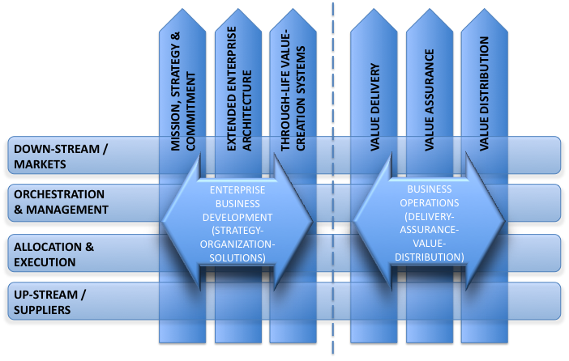
An AlphaFields 6x6x6 Transformation/Renewal Coordination Matrix …requires integration across systematic strategy-to-operations transformation
Continuous review, steering, and
orchestration of progress at
improving six categories:
speed,
innovation,
service levels,
cost effectiveness,
business alignment and
“platforms”.
Emphasis on cross-coordination across strategy-to-operations through-life transformation

Slide 7
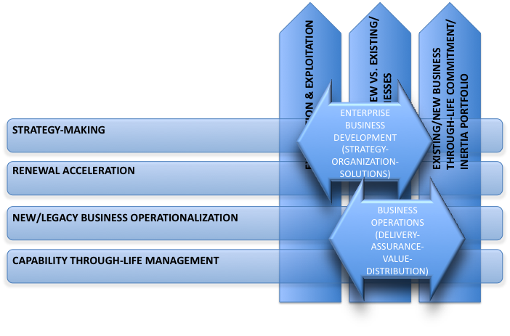
An AlphaFields 6x6x6 Transformation/Renewal Coordination Matrix …requires integration across renewal vs. legacy-inertia transformation
Continuous review, steering, and
orchestration of progress at
improving six categories:
speed,
innovation,
service levels,
cost effectiveness,
business alignment and
“platforms”.
Emphasis on cross-coordination across the renewal vs. legacy commitment-inertia transformation integration

Slide 8
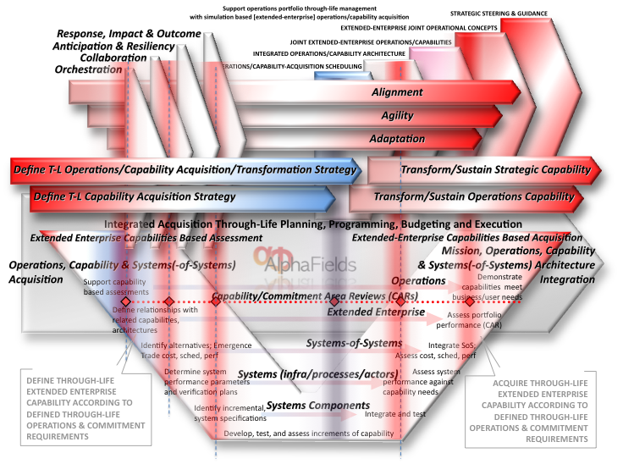
An AlphaFields 6x6x6 Transformation/Renewal Coordination Matrix …requires integration across the entire [extended] systems-enterprise transformation
Continuous review, steering, and
orchestration of progress at
improving six categories:
speed,
innovation,
service levels,
cost effectiveness,
business alignment and
“platforms”.
Emphasis on cross-coordination across the renewal of the entire extended systems-enterprise

Slide 9
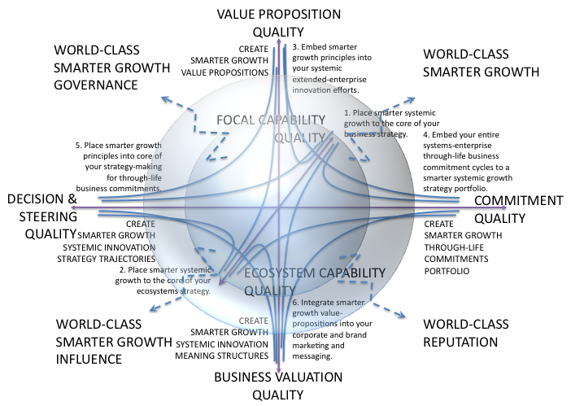
An AlphaFields 6x6x6 Transformation/Renewal Coordination Matrix …requires integration across the entire [extended] systems-enterprise transformation
Continuous review, steering, and
orchestration of progress at
improving six categories:
speed,
innovation,
service levels,
cost effectiveness,
business alignment and
“platforms”.
Emphasis on cross-coordination across the renewal of the entire extended systems-enterprise driver/enabler/operations scale-shift

Slide 10
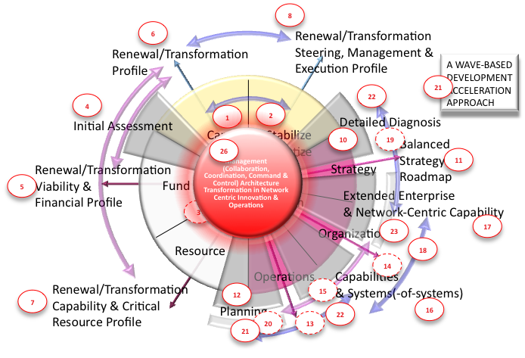
An AlphaFields 6x6x6 Transformation/Renewal Coordination Matrix …embedded within our robust renewal framework ensures the sustainable results…
Continuous review, steering, and
orchestration of progress at
improving six categories:
speed,
innovation,
service levels,
cost effectiveness,
business alignment and
“platforms”.
Emphasis on cross-coordination across the through-life steering, resourcing, and transformation execution

Slide 11
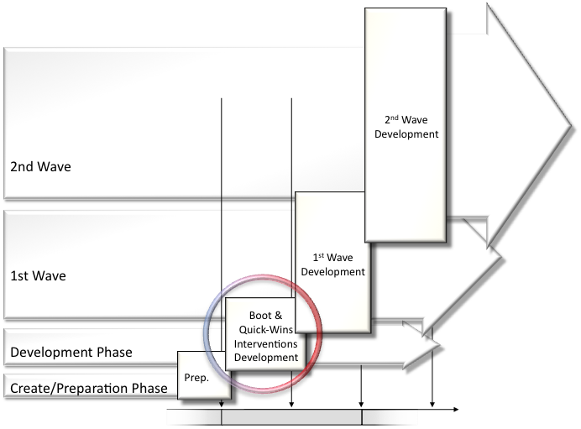
An AlphaFields 6x6x6 Transformation/Renewal Coordination Matrix …embedded within our robust renewal framework ensures the sustainable results…
Continuous review, steering, and
orchestration of progress at
improving six categories:
speed,
innovation,
service levels,
cost effectiveness,
business alignment and
“platforms”.
Emphasis on cross-coordination across the through-life steering, resourcing, and transformation execution

Slide 12
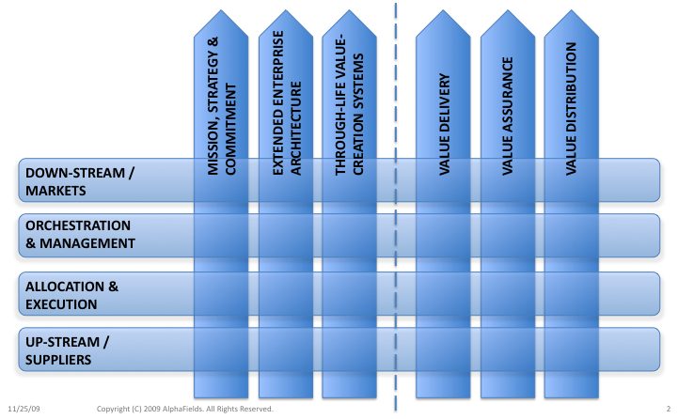
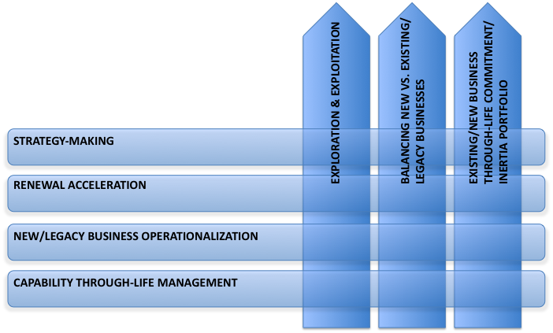
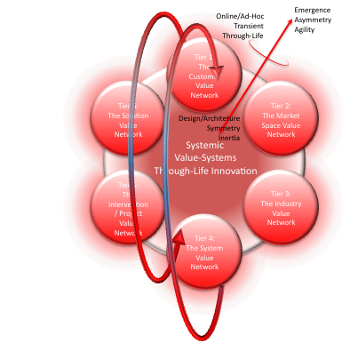
…leading to a "Six by Six …by Six (+1)” transformation approach
Extended Enterprise Speed, Agility & Resiliency
Through-Life Value-Creation-Systems Innovation
Extended-Enterprise Operational Service
Levels
Systems-Enterprise Business
Alignment
Sustainable Cost
Effectiveness & Commitment
Platforms, Capabilities &
Operations
Extended Enterprise Speed, Agility & Resiliency
2
Through-Life Value-Creation-Systems Innovation
2
2
Extended-Enterprise Operational Service
Levels
Systems-Enterprise Business
Alignment
2
2
Sustainable Cost
Effectiveness & Commitment
Platforms, Capabilities &
Operations
2
2
denotes ”second-order” change acceleration

Slide 13
Enable fast-track/accelerated transformation/renewal …while ensuring operational delivery robustness…
Continuous review, steering, and
orchestration of progress at
improving six categories:
speed,
innovation,
service levels,
cost effectiveness,
business alignment and
“platforms”.
Emphasis on cross-coordination across multiple concurrent domains
Extended Enterprise
Speed, Agility &
Resiliency
Platforms,
Capabilities &
Operations
Through-Life
Value-Creation-Systems
Innovation
Systems-Enterprise
Business
Alignment
Extended-Enterprise
Operational Service
Levels
Sustainable Cost
Effectiveness &
Commitment

Slide 14
Enable fast-track/accelerated transformation/renewal …while aligning the innovative transformation elements…
Continuous review, steering, and
orchestration of progress at
improving six categories:
speed,
innovation,
service levels,
cost effectiveness,
business alignment and
“platforms”.
Emphasis on cross-coordination across multiple concurrent domains
Extended Enterprise
Speed, Agility &
Resiliency
Platforms,
Capabilities &
Operations
Through-Life
Value-Creation-Systems
Innovation
Systems-Enterprise
Business
Alignment
Extended-Enterprise
Operational Service
Levels
Sustainable Cost
Effectiveness &
Commitment

Slide 15
Enable fast-track/accelerated transformation/renewal …while ensuring sustainable systemic innovation robustness…
Continuous review, steering, and
orchestration of progress at
improving six categories:
speed,
innovation,
service levels,
cost effectiveness,
business alignment and
“platforms”.
Emphasis on cross-coordination across multiple concurrent domains
Extended Enterprise
Speed, Agility &
Resiliency
Platforms,
Capabilities &
Operations
Through-Life
Value-Creation-Systems
Innovation
Systems-Enterprise
Business
Alignment
Extended-Enterprise
Operational Service
Levels
Sustainable Cost
Effectiveness &
Commitment

Slide 16
Enable fast-track/accelerated transformation/renewal …while aligning operational delivery robustness & through-life commitments transformation to systemic sustainable innovation…
Continuous review, steering, and
orchestration of progress at
improving six categories:
speed,
innovation,
service levels,
cost effectiveness,
business alignment and
“platforms”.
Emphasis on cross-coordination across multiple concurrent domains
Extended Enterprise
Speed, Agility &
Resiliency
Platforms,
Capabilities &
Operations
Through-Life
Value-Creation-Systems
Innovation
Systems-Enterprise
Business
Alignment
Extended-Enterprise
Operational Service
Levels
Sustainable Cost
Effectiveness &
Commitment

Slide 17
Enable fast-track/accelerated transformation/renewal …while aligning operational delivery with enabling capabilities etc transformation…
Continuous review, steering, and
orchestration of progress at
improving six categories:
speed,
innovation,
service levels,
cost effectiveness,
business alignment and
“platforms”.
Emphasis on cross-coordination across multiple concurrent domains
Extended Enterprise
Speed, Agility &
Resiliency
Platforms,
Capabilities &
Operations
Through-Life
Value-Creation-Systems
Innovation
Systems-Enterprise
Business
Alignment
Extended-Enterprise
Operational Service
Levels
Sustainable Cost
Effectiveness &
Commitment

Slide 18
Enable fast-track/accelerated transformation/renewal …while aligning systemic sustainable innovation with short-to-long-term & strategic-to-operational extended-enterprise business alignment…
Continuous review, steering, and
orchestration of progress at
improving six categories:
speed,
innovation,
service levels,
cost effectiveness,
business alignment and
“platforms”.
Emphasis on cross-coordination across multiple concurrent domains
Extended Enterprise
Speed, Agility &
Resiliency
Platforms,
Capabilities &
Operations
Through-Life
Value-Creation-Systems
Innovation
Systems-Enterprise
Business
Alignment
Extended-Enterprise
Operational Service
Levels
Sustainable Cost
Effectiveness &
Commitment

Slide 19
Enable fast-track/accelerated transformation/renewal …while aligning speed, agility and resiliency with sustainable performance levels and related enablers…
Continuous review, steering, and
orchestration of progress at
improving six categories:
speed,
innovation,
service levels,
cost effectiveness,
business alignment and
“platforms”.
Emphasis on cross-coordination across multiple concurrent domains
Extended Enterprise
Speed, Agility &
Resiliency
Platforms,
Capabilities &
Operations
Through-Life
Value-Creation-Systems
Innovation
Systems-Enterprise
Business
Alignment
Extended-Enterprise
Operational Service
Levels
Sustainable Cost
Effectiveness &
Commitment

Slide 20
…Such multiple concurrent perspectives coordination require an expansion of a ”flat Six-by-Six” perspective into a more elaborate transformation/renewal coordination approach…
Extended Enterprise Speed, Agility & Resiliency
Through-Life Value-Creation-Systems Innovation
Extended-Enterprise Operational Service
Levels
Systems-Enterprise Business
Alignment
Sustainable Cost
Effectiveness & Commitment
Platforms, Capabilities &
Operations
Extended Enterprise Speed, Agility & Resiliency
2
Through-Life Value-Creation-Systems Innovation
2
2
Extended-Enterprise Operational Service
Levels
Systems-Enterprise Business
Alignment
2
2
Sustainable Cost
Effectiveness & Commitment
Platforms, Capabilities &
Operations
2
2
denotes ”second-order” change acceleration

Slide 21
…"Six by Six …by Six (+1)” transformation/renewal coordination approach
Extended Enterprise Speed, Agility & Resiliency
Through-Life Value-Creation-Systems Innovation
Extended-Enterprise Operational Service
Levels
Systems-Enterprise Business
Alignment
Sustainable Cost
Effectiveness & Commitment
Platforms, Capabilities &
Operations
Extended Enterprise Speed, Agility & Resiliency
2
Through-Life Value-Creation-Systems Innovation
2
2
Extended-Enterprise Operational Service
Levels
Systems-Enterprise Business
Alignment
2
2
Sustainable Cost
Effectiveness & Commitment
Platforms, Capabilities &
Operations
2
2
denotes ”second-order” change acceleration

Slide 22
"Six by Six …by Six (+1)” transformation/renewal coordination across…
Extended Enterprise Speed, Agility & Resiliency
Through-Life Value-Creation-Systems Innovation
Extended-Enterprise Operational Service
Levels
Systems-Enterprise Business
Alignment
Sustainable Cost
Effectiveness & Commitment
Platforms, Capabilities &
Operations
Extended Enterprise Speed, Agility & Resiliency
2
Through-Life Value-Creation-Systems Innovation
2
Extended Enterprise Speed, Agility & Resiliency
2
Extended-Enterprise Operational Service
Levels
Systems-Enterprise Business
Alignment
2
2
Sustainable Cost
Effectiveness & Commitment
Platforms, Capabilities &
Operations
2
2
denotes ”second-order” change acceleration

Slide 23
"Six by Six …by Six (+1)” transformation/renewal coordination across…
Extended Enterprise Speed, Agility & Resiliency
Through-Life Value-Creation-Systems Innovation
Extended-Enterprise Operational Service
Levels
Systems-Enterprise Business
Alignment
Sustainable Cost
Effectiveness & Commitment
Platforms, Capabilities &
Operations
Extended Enterprise Speed, Agility & Resiliency
2
Through-Life Value-Creation-Systems Innovation
2
Through-Life Value-Creation-Systems Innovation
2
Extended-Enterprise Operational Service
Levels
Systems-Enterprise Business
Alignment
2
2
Sustainable Cost
Effectiveness & Commitment
Platforms, Capabilities &
Operations
2
2
denotes ”second-order” change acceleration

Slide 24
"Six by Six …by Six (+1)” transformation/renewal coordination across…
Extended Enterprise Speed, Agility & Resiliency
Through-Life Value-Creation-Systems Innovation
Extended-Enterprise Operational Service
Levels
Systems-Enterprise Business
Alignment
Sustainable Cost
Effectiveness & Commitment
Platforms, Capabilities &
Operations
Extended Enterprise Speed, Agility & Resiliency
2
Through-Life Value-Creation-Systems Innovation
2
Extended-Enterprise Operational Service
Levels
2
Extended-Enterprise Operational Service
Levels
Systems-Enterprise Business
Alignment
2
2
Sustainable Cost
Effectiveness & Commitment
Platforms, Capabilities &
Operations
2
2
denotes ”second-order” change acceleration

Slide 25
"Six by Six …by Six (+1)” transformation/renewal coordination across…
Extended Enterprise Speed, Agility & Resiliency
Through-Life Value-Creation-Systems Innovation
Extended-Enterprise Operational Service
Levels
Systems-Enterprise Business
Alignment
Sustainable Cost
Effectiveness & Commitment
Platforms, Capabilities &
Operations
Extended Enterprise Speed, Agility & Resiliency
2
Through-Life Value-Creation-Systems Innovation
2
Systems-Enterprise Business
Alignment
2
Extended-Enterprise Operational Service
Levels
Systems-Enterprise Business
Alignment
2
2
Sustainable Cost
Effectiveness & Commitment
Platforms, Capabilities &
Operations
2
2
denotes ”second-order” change acceleration

Slide 26
"Six by Six …by Six (+1)” transformation/renewal coordination across…
Extended Enterprise Speed, Agility & Resiliency
Through-Life Value-Creation-Systems Innovation
Extended-Enterprise Operational Service
Levels
Systems-Enterprise Business
Alignment
Sustainable Cost
Effectiveness & Commitment
Platforms, Capabilities &
Operations
Extended Enterprise Speed, Agility & Resiliency
2
Through-Life Value-Creation-Systems Innovation
2
Sustainable Cost
Effectiveness & Commitment
2
Extended-Enterprise Operational Service
Levels
Systems-Enterprise Business
Alignment
2
2
Sustainable Cost
Effectiveness & Commitment
Platforms, Capabilities &
Operations
2
2
denotes ”second-order” change acceleration

Slide 27
"Six by Six …by Six (+1)” transformation/renewal coordination across…
Extended Enterprise Speed, Agility & Resiliency
Through-Life Value-Creation-Systems Innovation
Extended-Enterprise Operational Service
Levels
Systems-Enterprise Business
Alignment
Sustainable Cost
Effectiveness & Commitment
Platforms, Capabilities &
Operations
Extended Enterprise Speed, Agility & Resiliency
2
Through-Life Value-Creation-Systems Innovation
2
Platforms, Capabilities
&
Operations
2
Extended-Enterprise Operational Service
Levels
Systems-Enterprise Business
Alignment
2
2
Sustainable Cost
Effectiveness & Commitment
Platforms, Capabilities &
Operations
2
2
denotes ”second-order” change acceleration

Slide 28
Transformation Matrix integrated to a full-spectrum parallel governance streams framework across multiple governance perspectives…
STRATEGIC
GOVERNANCE
Support & leverage…
STRATEGIC THROUGH-LIFE
GOVERNANCE PERSPECTIVE
+
2
REVIEW,
STEERING
BUSINESS
RESILIENCY
BUSINESS
VIABILITY &
CORE
RESOURCES
ORHESTRATION
3
7
RESILIENT
GROWTH
1
Through-life “disciplines/systems/life-phases” conceptual framework
EXTENDED
ENTERPRISE
ORCHESTRATION
OPERATIONS/
EXECUTION
4
6
CAPABILITY
INTEGRATION
THROUGH-LIFE
EXECUTION PERSPECTIVE
THROUGH-LIFE
ORGANIZATION &
ORCHESTRATION
PERSPECTIVE
5

Slide 29
Each governance area has CORE/ENABLERS/SUPPORT and HEADING/ORCHESTRATION/EXECUTION activities for full-spectrum project & business governance
STRATEGIC
GOVERNANCE
REVIEW,
STEERING
BUSINESS
RESILIENCY
FINANCE
SUPPORT
FINANCE
ENABLERS
BUSINESS
VIABILITY
CORE
RESILIENT
GROWTH
EXTENDED
ENTERPRISE
ORCHESTRATION
HEADING
CAPABILITY
INTEGRATION
ORCHESTRATION
EXECUTION

Slide 30
Approach Benefits
Approach
Holistic Enterprise Transformation Coordination Approach
Sustainable Impacts Oriented
Practice & Results Oriented
Strong Academic Support For Abstraction, Analysis & Synthesis
Builds On Non-Competitive Cross-Industry Collaboration Process
Collaborative, Leveraging & Benchmarking
Strong Review & Steering
Vehicle
Aggressive, Phased & Pre-Programmed SPRINGBOARD Process
Continuous, Pervasive Enterprise-Wide Coordination Processes and Mechanisms
Strong Emphasis On Building On Process Emergence
Benefits
Strong Analysis Of Key Challenges
Identification Of Key Systemic Issues To Address
Robust Enterprise-Wide Strategy-Making & Decision-Making Management Architecture
Well-Integrated Co-Exploration, Co-Implementation and Delivery of Systemic Through-Life Transformation & Renewal
Enterprise-Wide Collaborative Creation and Implementation of Sustainable Solutions
Effective Transfer of World-Class Insights & Capabilities For Increased Performance & Renewal Capability

Slide 31
#AWS20100302001 AlphaFields 6x6x6 Transformation Coordination Matrix
A Systematic Transformation & Renewal Coordination Approach
for Extended-Enterprise Transformation Acceleration
https://www.alphafields.com

Slide 32
For further information, contact
Eero Hollming
+358 40 865 9350
ehollming@gmail.com

