Slide 3
I grew up in a country with no resources but people, which made a choice for all people to prosper. How did Singapore do it?

Slide 4
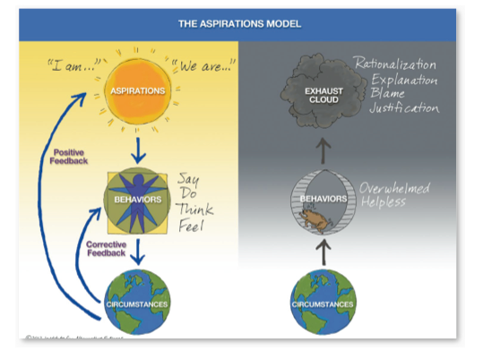

Slide 5
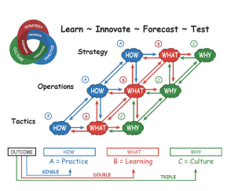
Strategic Triple Feedback Loop takes Practice to Learning to Culture
Health Outcomes require
Strategic, Operational &
Tactical Actions with
Transparent alignment of
WHY, WHAT and HOW
Learning Feedback
Loops assure we
always know WHY
we are doing WHAT
we are doing to assure that
HOW we are doing it is
in alignment* within the
Network.
Source: Douglas Engelbart
Memorial Memento July 13 2014

